Slide 1

TEAM NUMBER: 14
SREE NITHYA -1602-20-737-110
KRISHNA SAI-1602-20-737-077
SOHAIL AKBAR-1602-20-737-106
This Photo by Unknown author is licensed under CC BY.

Slide 2
PROBLEM STATEMENT :
To create an web application which helps to minimize the food wastage effectively by rescuing the excess food from weddings, parties, organizations, restaurants and temples and redeploying food resources in an efficient manner.

Slide 3
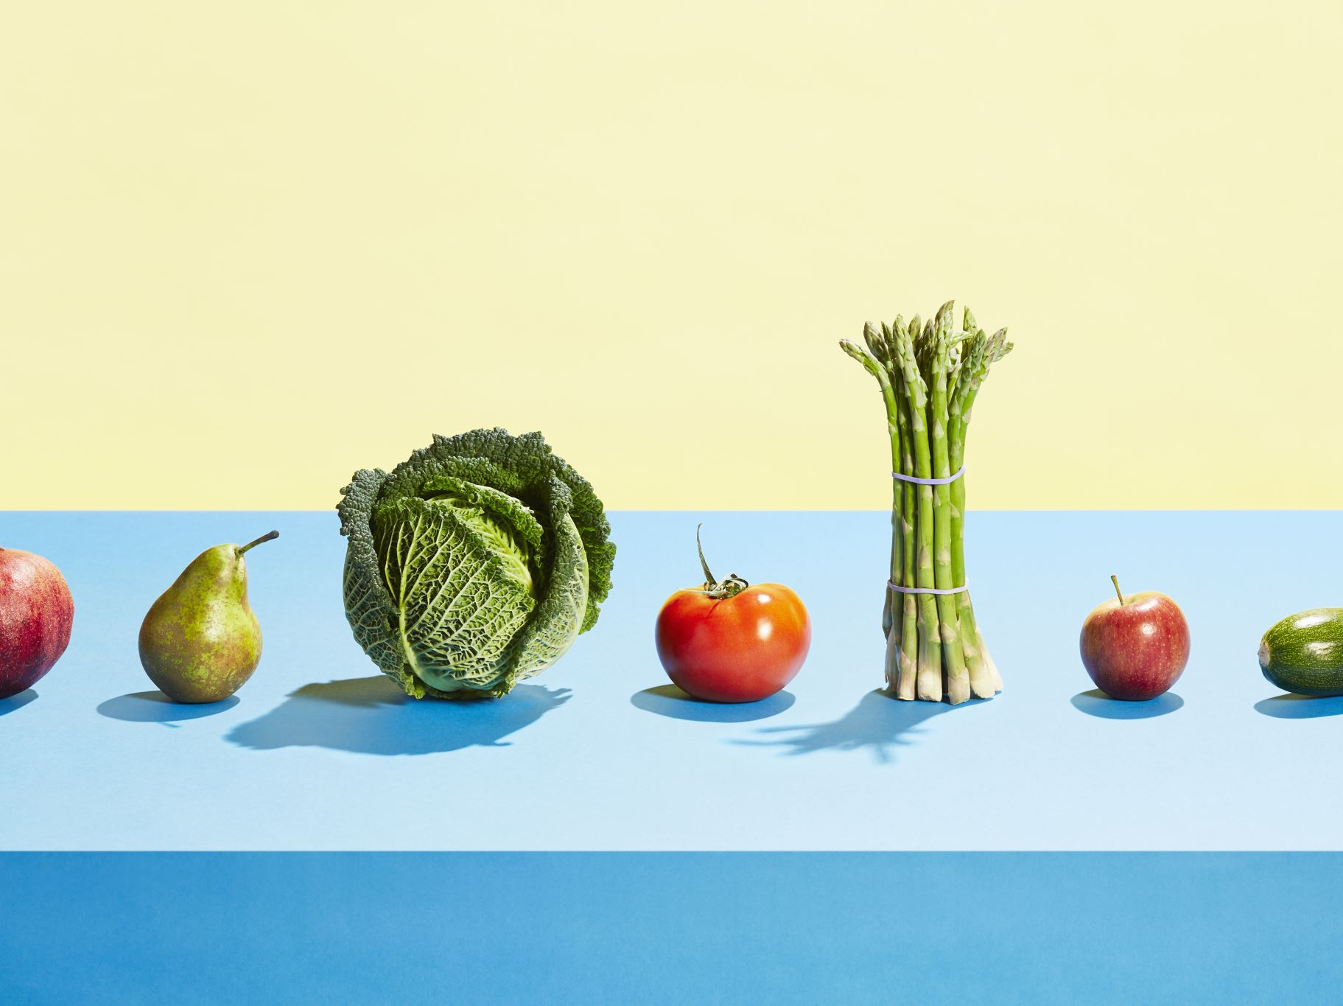
INTRODUCTION
Food for thought is a web based technology which manages foods. This web application provides interface between food donor and food require. In this application food donor enter their food quantity details and addresses.
The donator can create the account and whenever they are having wastage food they can login and give request to the admin. The admin collect foods from donator through their nearby agent then provide to nearest orphanages or poor people.
This project is food redistribution is an enormously successful social innovation that tackles food waste and food poverty. The donor details are maintained confidential because it maintains a separate account for each donor.

Slide 4
Abstract
In recent times, food wastage is increasing at an unprecedented rate and creating a negative effect on the economic growth factors. This in turn creates a major impact on the agricultural processing industries. As food recycling is always remaining as a complex task, in this project, we are focusing mainly on the food wastage in the office premises, wedding, events etc.
This web application is used to manage wastage foods in a useful way. Every day the people are wasting lots of foods. So we have to reduce that food wastage problem through online.

Slide 5

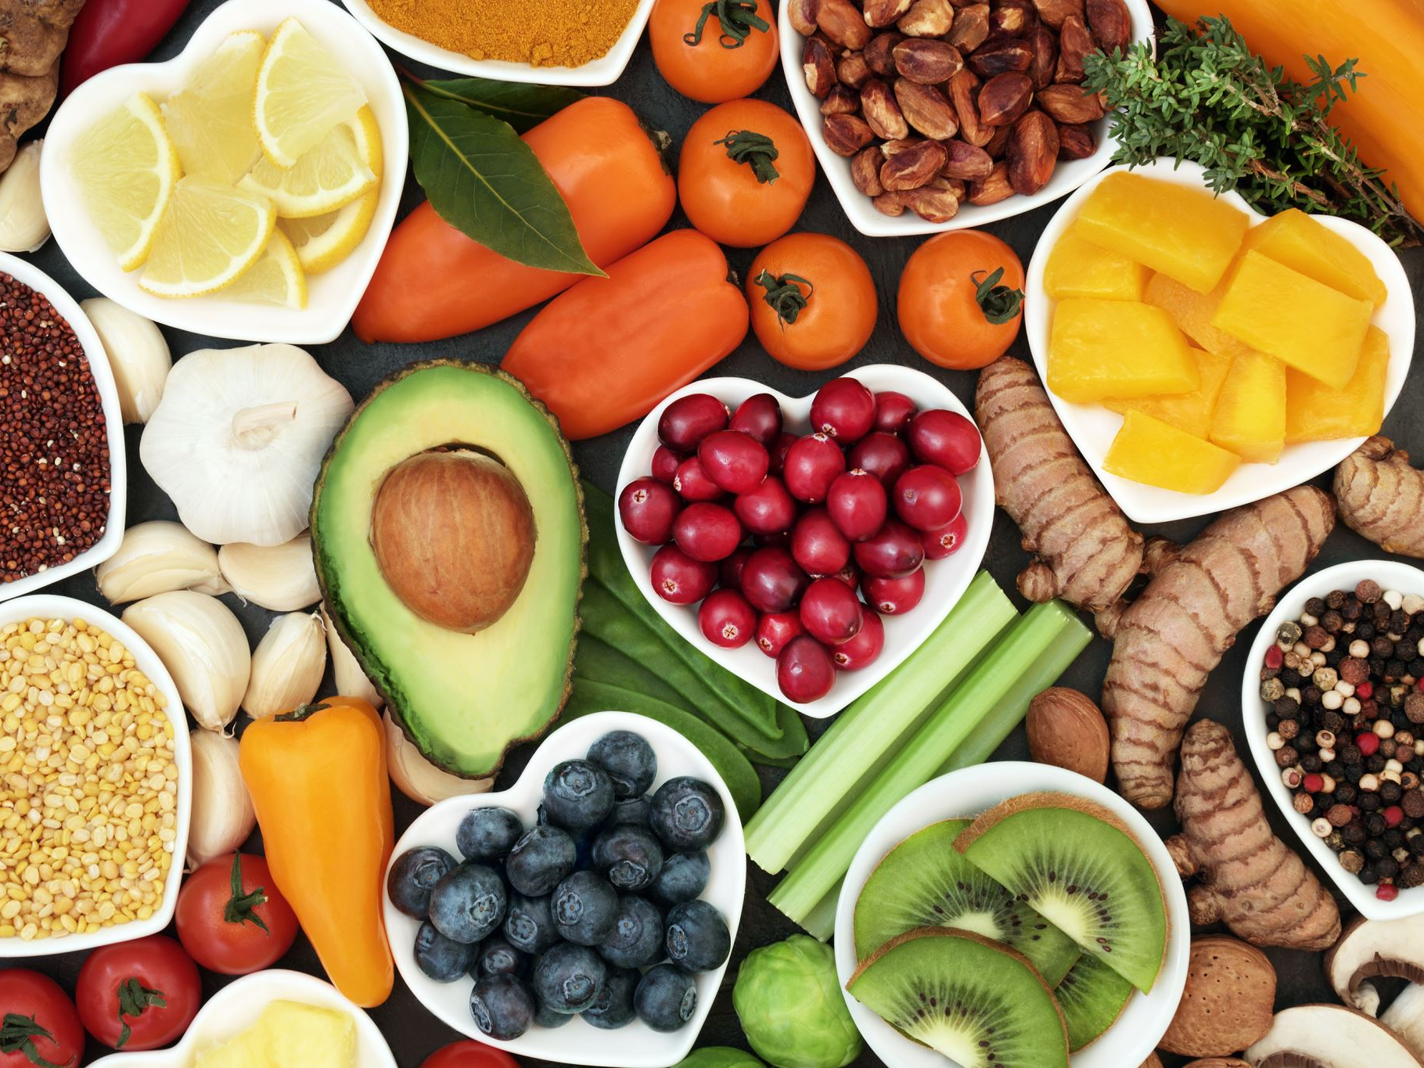
Admin Module
Secure admin login system
Dashboard: In this section, admin can view total state, total city, Total Food Donor, Total Listed Food, All Food Request, New Food Request, Rejected Food Request and Completed Food Request,.
State: In this section, admin can manage state (Add/Update/Del).
City: In this section, admin can manage city (Add/Update/Del).
Reg Food Donor: In this section, admin can view registered food donor.
Listed Food: In this section, admin can view the listed food by food donor.
Food Request: In this section, admin can view the request for food which is send user.
Enquiry: In this section, admin can view and maintain the inquiry.
Pages: In this section, admin can manage about us and contact us pages.
Search Listed Food: In this section admin, search food request by request number.
Reports: In this section admin can view donated food and registered food donor in particular period
Admin can also update his profile, change the password and recover the password.

Slide 6
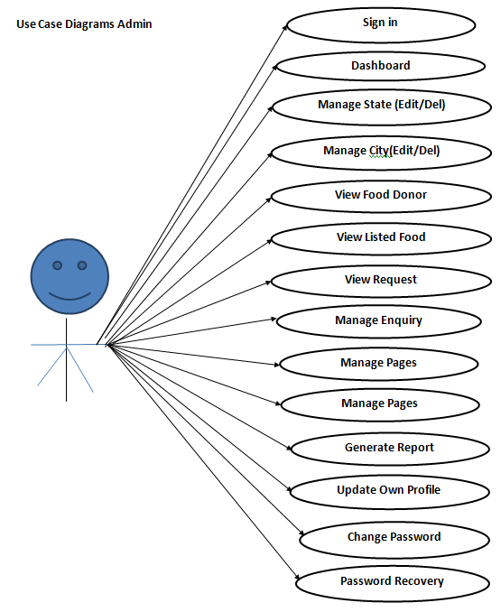
Use Case Diagram
Notes:
USECASE DIAGRAM: A Use case is a description of set of sequence of actions. Graphically it is rendered as an ellipse with solid line including only its name. Use case diagram is a behavioral diagram that shows a set of use cases and actors and their relationship. It is an association between the use cases and actors. An actor represents a real-world object. Primary Actor – Sender, Secondary Actor Receiver.

Slide 7
Donor Module
Signup: In this section, Donor can register yourself.
Sign in: After successful registration Donor can login with valid credentials.
Dashboard: In this section, donor can view total listed food and total food take away.
List Your Food Detail: In this section, donor can list the donated food detail.
Request: In this section, donor can view the request which is send by user.
Search: In this section, donor can search food request by request number.
Donor can also update his profile, change the password and recover the password.

Slide 8
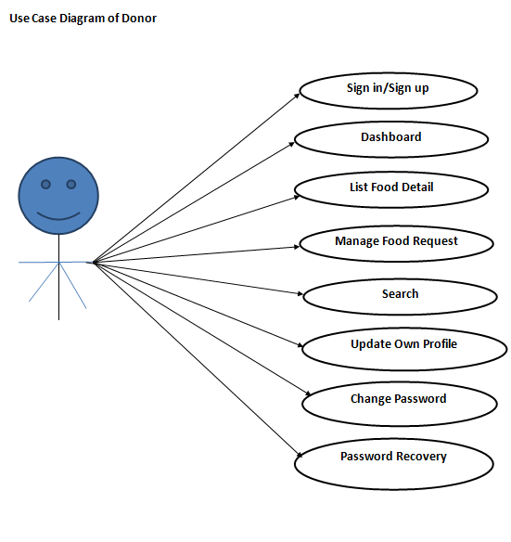
Use Case Diagram

Slide 9
User Module
Home
Home: User can visit the website and check the details.
See
About Us: User can see the details of the website.
Contact
Contact Us: User can see the contact detail and contact the website administrator.
View
Food Available List: User can view available donated food and send the request for food.
Request
Request Food: User can also request for available food.

Slide 10
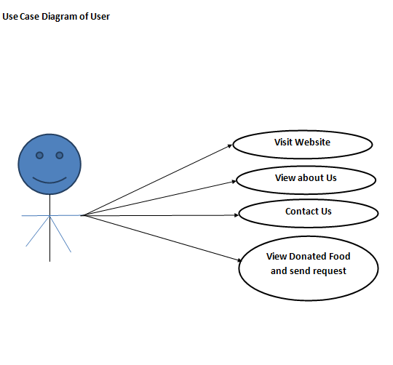
Use Case Diagram

Slide 11
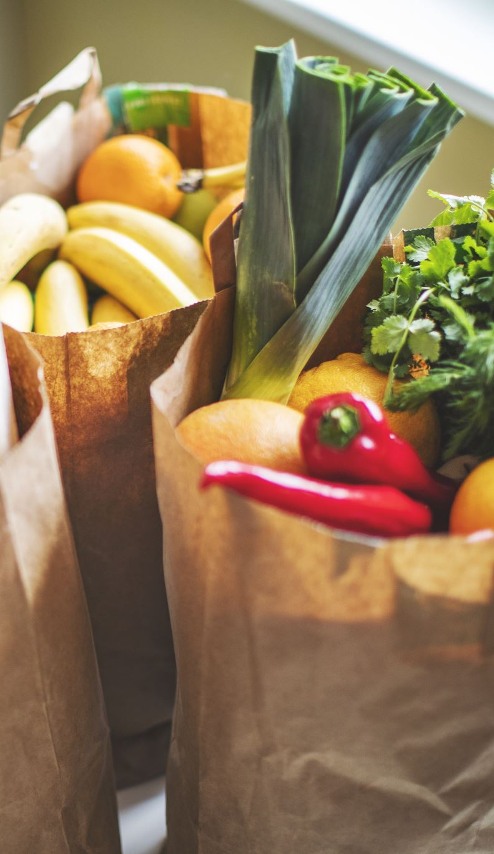
Scope of the Project
In proposed system we are reduce that food wastage using that application. This project is food redistribution is an enormously successful social innovation that tackles food waste and food poverty. The admin collect foods from donator through their nearby agent then provide to nearest orphanages or poor people.
→ Admin
→ Donor
→ User

Slide 12

Conclusion
The project titled as Food For Thought was deeply studied and analyzed to design the code and implement. It was done under the guidance of the experienced project guide. All the current requirements and possibilities have been taken care during the project time.
In our project, we are targeting the person who wants to donate wastage food this will create a greater impact on the cost saving as well as the food wastage management system, and there will be greater impact on the day by day food wastage. In our future work, we will try to integrate with other emerging technology such as block chain and also it will cover more areas.

Slide 13

Thank You

